Slide 1
CEIS 114 Module 3
Creating the Traffic Controller

Slide 2
Rubric – Due at the end of Week 3
Activity | Requirement(s) | Points
Include a picture of your circuit | Picture of the breadboard with LEDs ON | 30
Screenshot of code showing your name in comment | Screenshot of code in Arduino IDE showing your name in one of the comments | 30

Slide 3
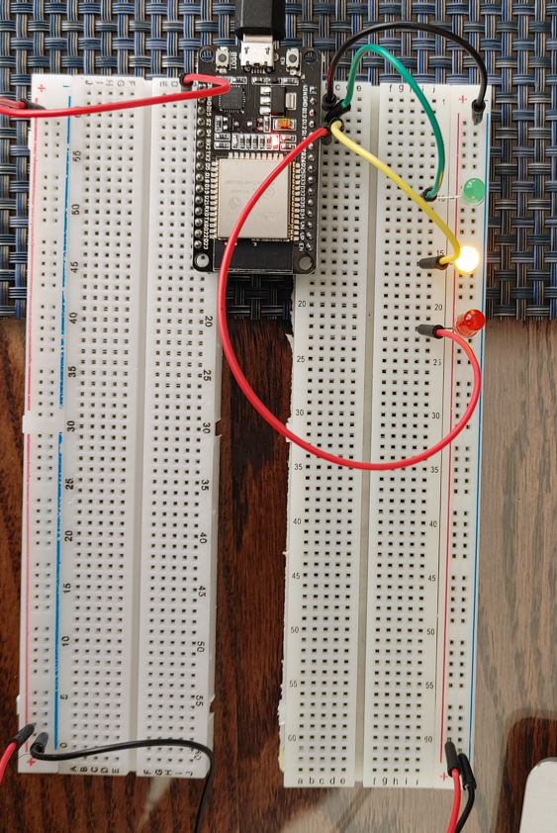
Picture of circuit with working LEDs
ESP 32 Board
Colored LEDs: Red, Yellow and Green
220 Ohm Resistors (optional)
Wires
Breadboard

Slide 4
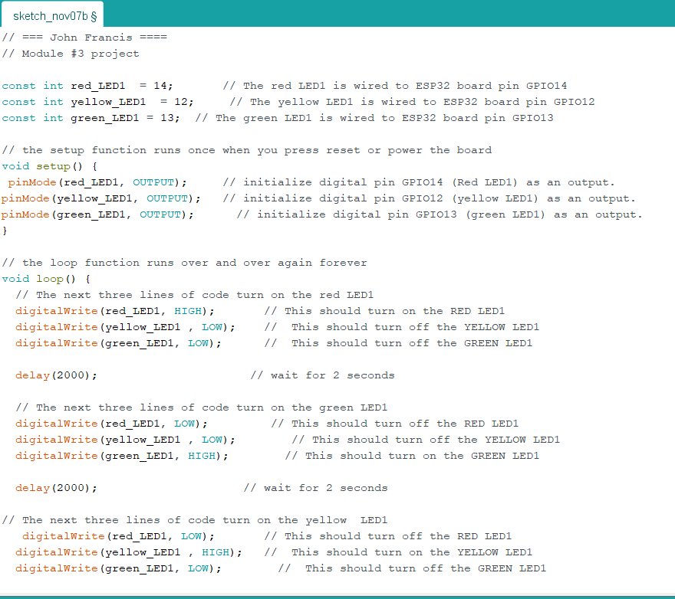
Screenshot of code in Arduino IDE
Screenshot of code in Arduino IDE showing your name in the comment

